Slide 1
CLAIMS MANAGEMENT SYSTEM TERMS AND CONDITONS: 1. DO NOT SHARE THE PROJECT TO ANYONE. 2. DO NOT SELL THE PROJECT IF YOU SELL WE HAVE TO TAKE ACTIONS. 3. DO NOT UPLOAD ON ANY GIT . KINDLY REQUEST YOU TO FOLLOW THE RULES
\

Slide 2
PROBLEM STATEMENT
A leading HealthCare Management Organization wants to strengthen its middleware by exposing the core logic related to Claims Management as Microservices.
The middleware Microservices are to be hosted on Cloud.
Member Portal to be developed that consumes these Microservices and responds back to members who are in need of Claim related information.

Slide 3
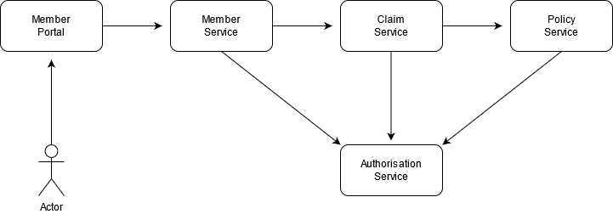
ARCHITECTURE/FLOW DIAGRAM

Slide 4
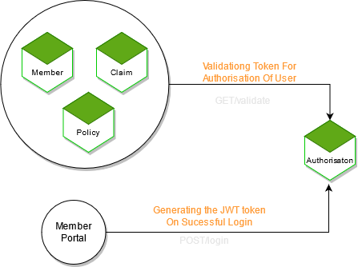
AUTH MODULE

Slide 5
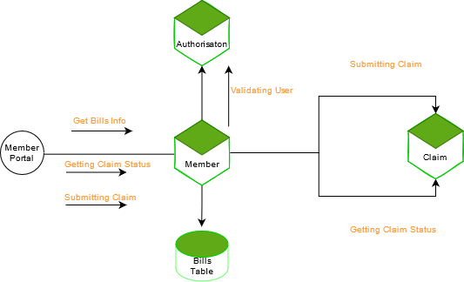
MEMBER MODULE

Slide 6
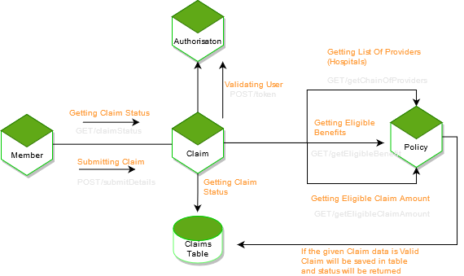
CLAIMS MODULE

Slide 7
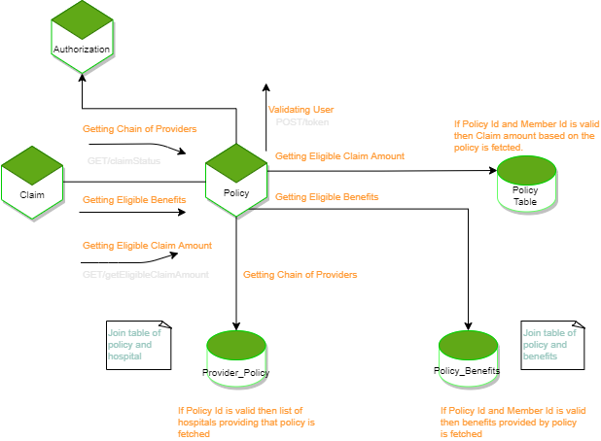
POLICY MODULE

Slide 8
Angular app hosted on S3 BUCKET

Slide 9
CLOUD DEPLOYMENT - CLUSTER(SERVICES)

Slide 10
CLOUD DEPLOYMENT - CLUSTER(TASKS)

Slide 11
CODE QUALITY USING SONARQUBE

Slide 12
CODE QUALITY USING SONARQUBE

Slide 13
CODE QUALITY USING SONARQUBE

Slide 14
CLOUD DEPLOYMENT - AUTH PIPELINE

Slide 15
CLOUD DEPLOYMENT - POLICY PIPELINE

